Slide 1


Department of Artificial Intelligence and Data
Science
Analyzing Classroom Behavior to Enhance Student Engagement and Learning Outcomes
Supervisor
Mr S Suresh kumar M.E.,(Ph.D) Professor
Atmakuru Siva Sandeep
(221801501)
Buvankalyan P
(221801506)

Slide 2
Problem Statement and Motivation
PROBLEM STATEMENT:
Develop a system to analyze classroom behavior data from video recordings or sensor data to identify patterns and factors influencing student engagement and learning.
MOTIVATION:
Enhanced learning outcomes
Identifying disengagement
Informed decision making

Slide 3
Abstract
The working of this project is to create an innovative system that uses video records to analyze classroom behavior and identify the key factors affecting student engagement and performance, this approach aims to improve student learning outcome, and promote teacher professional development by giving educators useful insights. In this method we use fast R-CNN to build the model.

Slide 4
Introduction and Overview of the Project.
The classroom is a dynamic and complicated place where a variety of factors interact to affect the learning outcome of student.
The aim of this project is to create an innovative system that can evaluate classroom behavior and identify signifivant factors influencing student engagement and learning. The system will make use of video recording. The proposed method will provide educators useful information to advance student learning outcome.

Slide 5
Literature Survey
S.No | Author Name | Paper Title | Description | Jornal | Volume/ Year
1 | Michael Johnson | A Framework for Classroom Behavior Monitoring Using Computer Vision | Integrates YOLO for real-time detection and tracking of student activities. | IEEE Trans. on Education | 2019
2 | Jane Smith | Machine Learning for Analyzing Classroom Behavior | Applies Random Forest and SVM to classify behaviors like attention and distraction. | IEEE Access | 2020
3 | John Doe | Automated Detection of Classroom Engagement Using Video Analysis | Uses CNN to detect student engagement through facial expressions and gestures in real-time. | IEEE Trans. on Affective Computing | 2021
4 | Richard Roe | Real-time Behavior Analysis in Educational Environments Using AI | Utilizes RNNs to analyze sequential video data for predicting classroom behaviors. | IEEE Trans. on Learning Technologies | 2022

Slide 6
Methodology
1.Problem Definition: Using a video-based system that recognizes student behaviours and offers teachers suggestion for enhancing engagement, the objective is to examine student involvement in the classroom.
2.Data Collection: Collecting dataset of classroom-related action and preparing training data by labelling image according to the predefined action

Slide 7
Methodology
3. Model selection and training: In this work we are using a pre-trained Faster R CNN model to detect the general actions and fine-tune the model with custom dataset to recognize classroom-specific action and we trained model to achieve the accurate detection
4. Video Processing Module: extracting frames from the uploaded video pre-process the frames to prepare them for action detection pass the frame to action and gesture detection module

Slide 8
Methodology
5. Action and Gesture Detection Module: Use the trained model to detect and classify actions in each frame and Recognize gesture and store the results including detected actions and their timestamps
6. Output Generation Module: Annotate the detected actions and gestures on the video frames and generate an output video that include labelled actions and gestures and create a text based report.

Slide 9
Methodology
7. Suggestion Generation Module: Analyze the detected actions and engagement metrics based and this generate suggestion for improving classroom engagement.
8. Web Interface Module: In this work we have provide a user friendly web interface where staff’s can upload the classroom video and the results will be displayed after the processing of the uploaded video

Slide 10
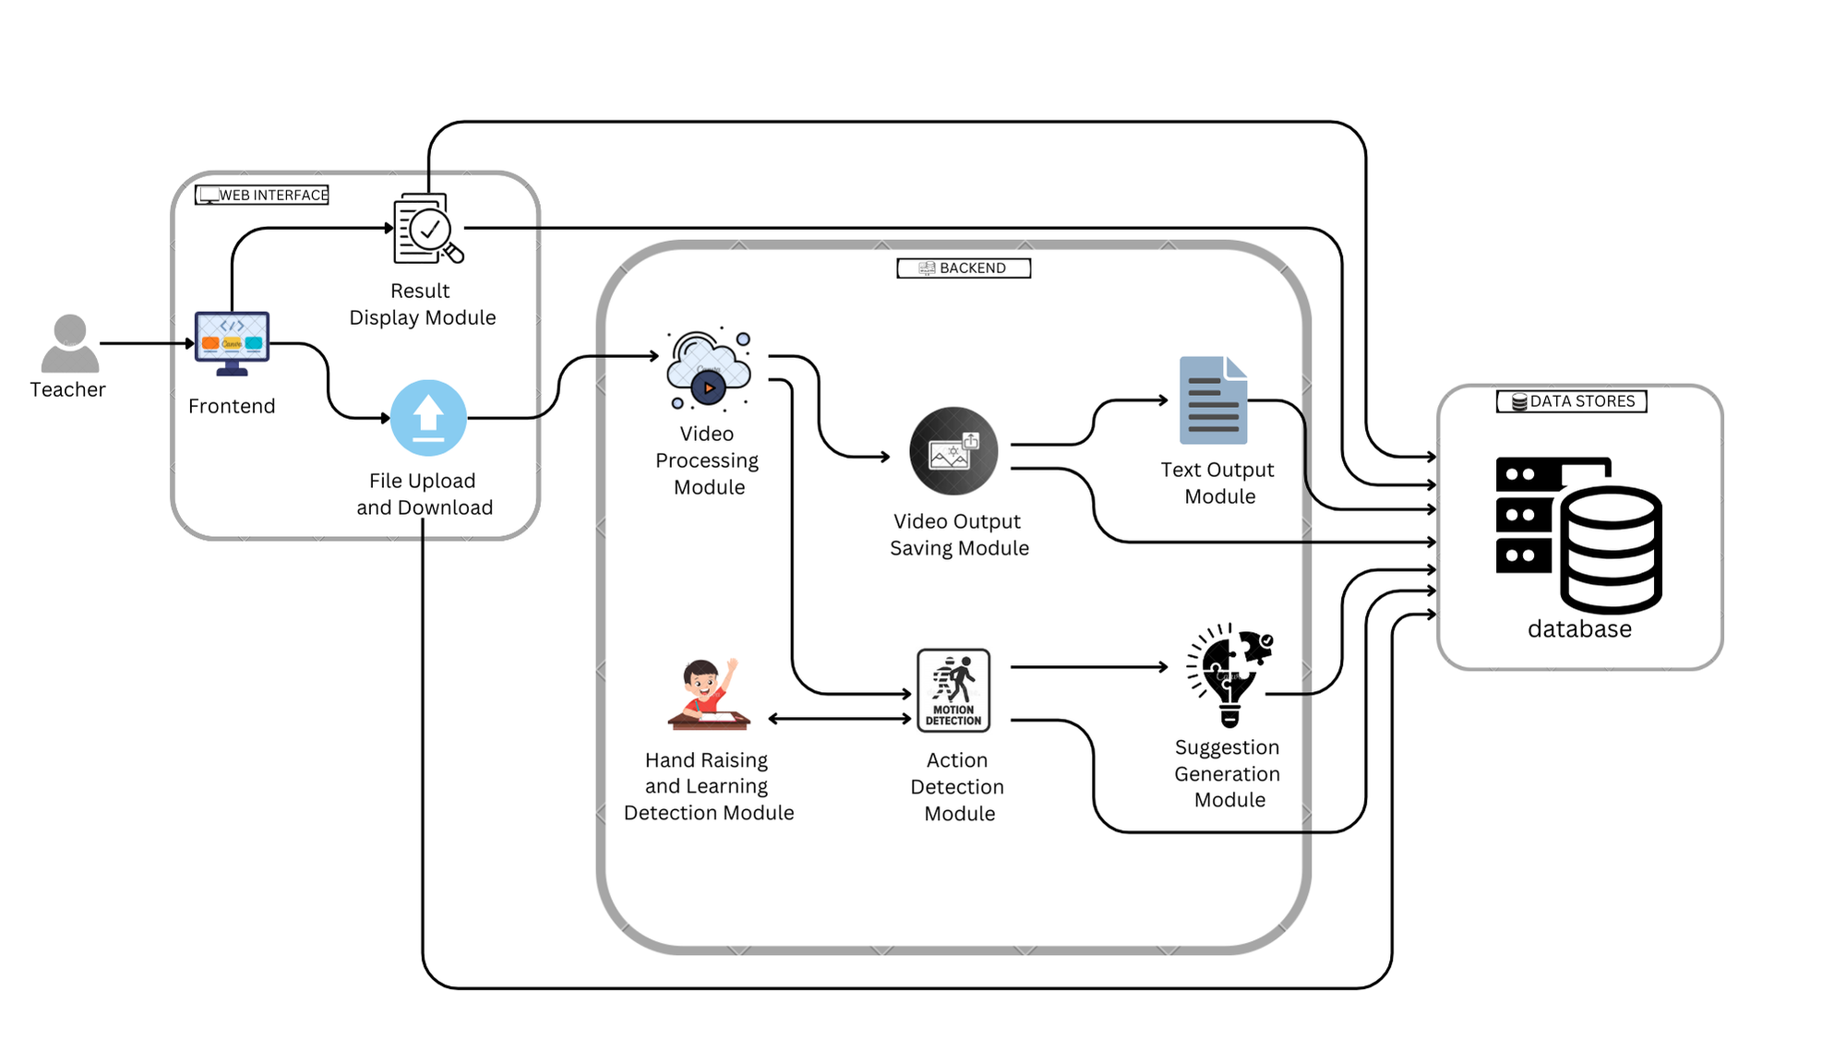
System Architecture

Slide 11
List of modules
Building the Faster R-CNN model
Video Processing Module
Action and Gesture Detection Module
Suggestion System Module
Web Interface Module

Slide 12
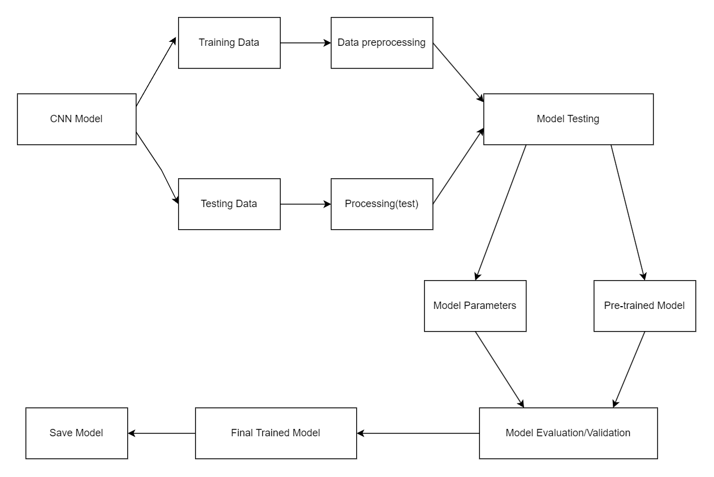
Building the Faster RCNN Model DFD.

Slide 13
Algorithm of Module 1.
Step 1 Data input: Feeding the labelled dataset containing images for human action
Step 2 Data Pre-processing: Resize images and normalize pixel values for model compatibility
Step 3 Feature Extraction: Using a pre-trained CNN to extract feature maps from the input image
Step 4 Region Proposal Network: it generate object proposals from the feature map

Slide 14
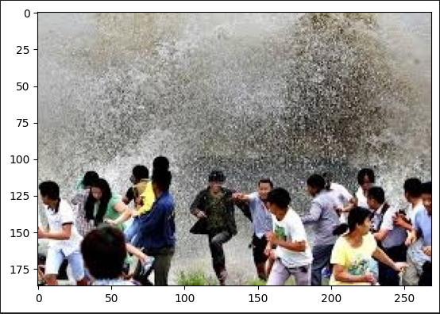
Algorithm of Module 1.
ROI Pooling: Apply ROI Pooling to the propsals, which that all proposals are of a fixed size.

Slide 15


Algorithm of Module 1.
Step 6 Classification and Bounding Box Regression Classification: Predict the probability of the action class using Softmax on Pooled ROI feature map.
Bounding Box Regressio: Refine the bounding box coordinates

Slide 16
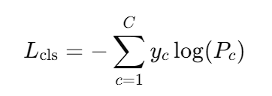
Algorithm of Module 1.
Step 7 Total Calculation: Total Loss is a combination of classification loss and bounding box regression loss.
Classification Loss:
which measures the difference between the true label distribution and the predicted probability distribution. It penalizes incorrect predictions by focusing on the probability of the correct class

Slide 17

Algorithm of Module 1.
Bounding box Loss:
used in object detection to measure the error between predicted and ground truth box coordinates.

Slide 18
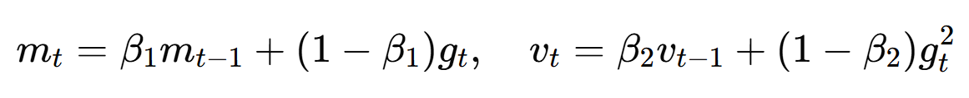
Algorithm of Module 1.
Step 8: Model training Optimize the model using ADAM optimizer.
Adam combines the benefits of momentum and adaptive learning rates, making it efficient and robust for optimizing deep learning models

Slide 19
Algorithm of Module 1.
Step 9: Evaluation and Validation and Save model: Validate the trained model using a metrics like accuracy precision, recall and mean average Precision and save the model in .onnx format

Slide 20
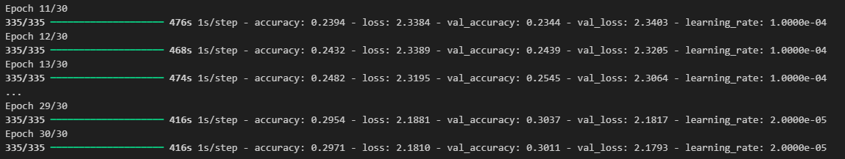
Output of Module 1

Slide 21
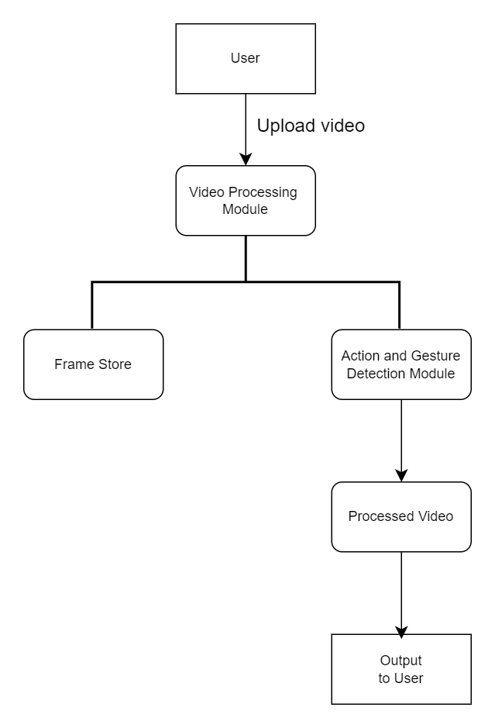
Video Processing Module DFD.

Slide 22

Algorithm of Module 2.
Step 1:Receive Video Input
Step 2:Initialize video capture
Step 3:Extract Frames
Step 4:Batch the frames

Slide 23

Algorithm of Module 2.
Step 5:Action Detection
Step 6:Save the processed video
Step 7:Send the processed output
Euclidean distance formula

Slide 24
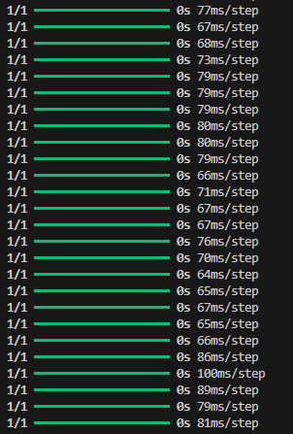
Output of Module 2

Slide 25
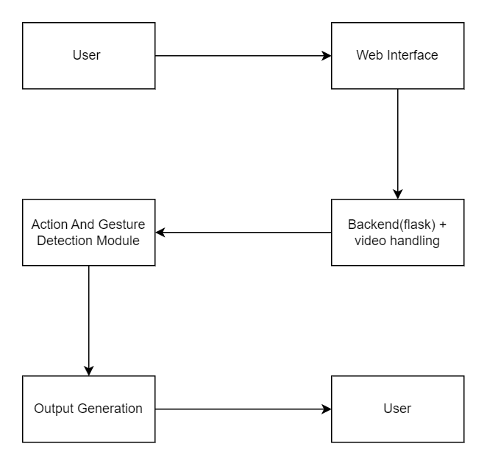
Action and Gesture Detection Module DFD.

Slide 26
Algorithm of Module 3.
Step 1: Video Frame Capture and Pre-processing: this resize the frame to the model input size and normalize pixel value by dividing it by 255.
Step 2: Action Recognition Model:
Use argmax to determine the predicted class with high probability.

Slide 27
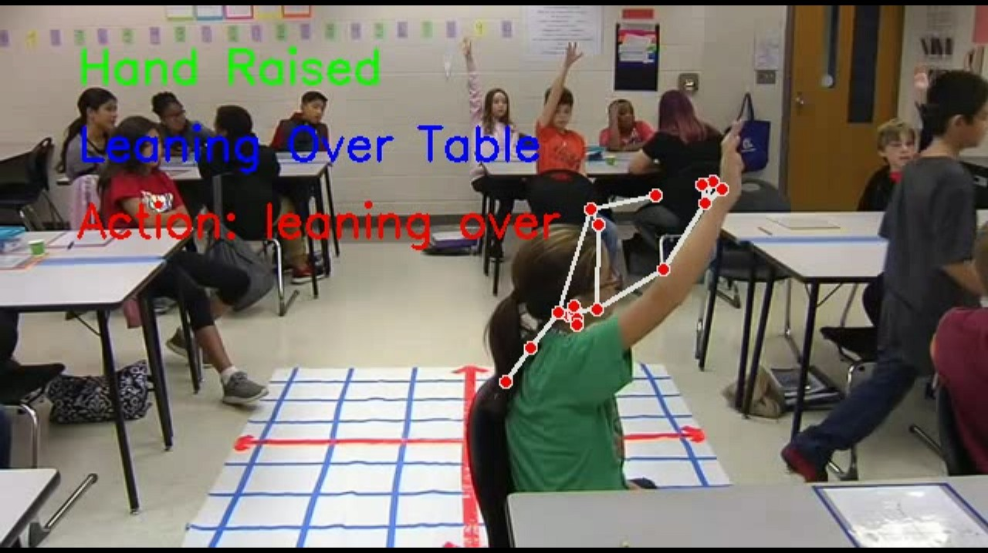
Output of Module 3

Slide 28
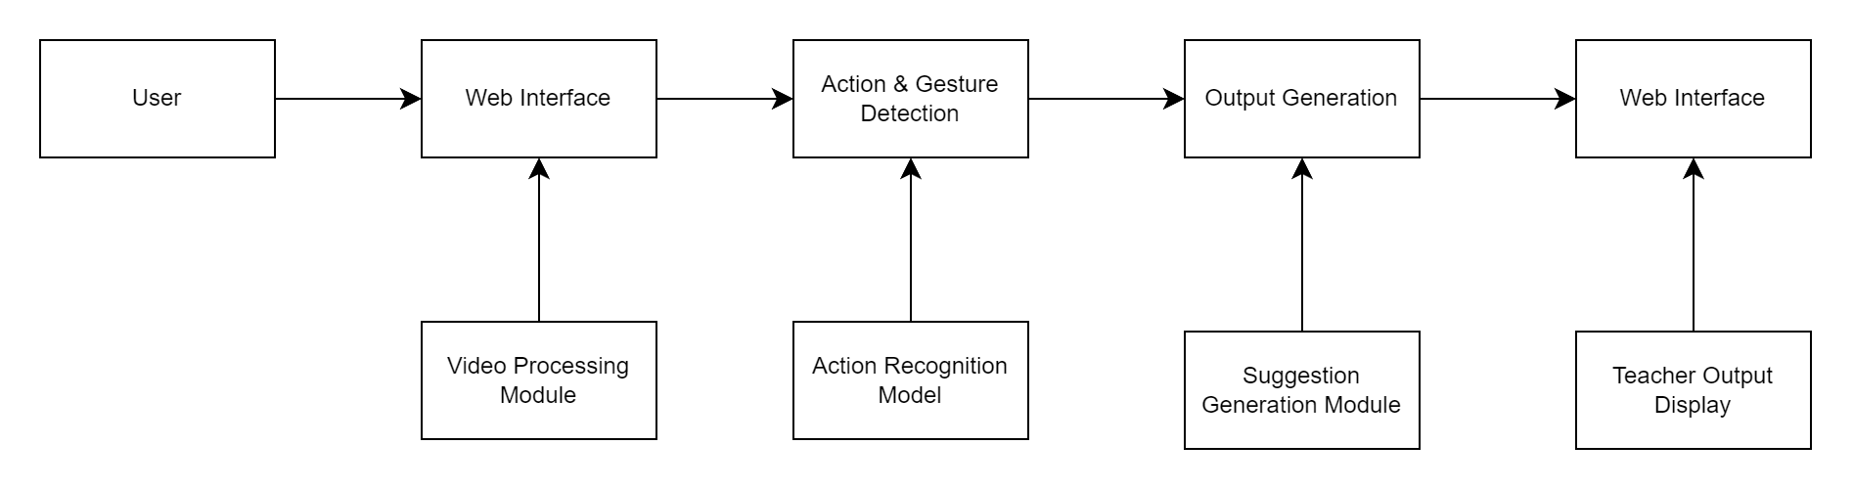
Suggestion System Module DFD.

Slide 29
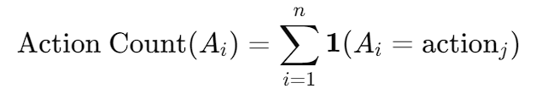
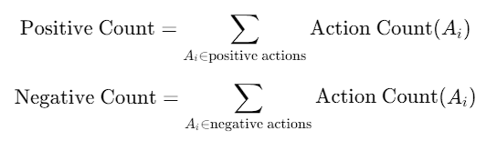
Algorithm of Module 4.
Step 1 Analyze Detection Action: Detection action and gesture from the action gesture detection module
Step 2: Classify Action as Positive or Negative:

Slide 30

Algorithm of Module 4.
Step 3 Determine Engagement Level: If the engagement level is high, provide encouraging feedback, if low suggest improvement
Step 4: Generate suggestion based on number of positive or negative in the engagement analysis.

Slide 31
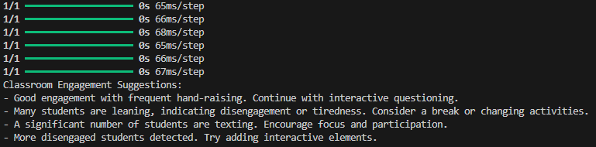
Output of Module 4

Slide 32
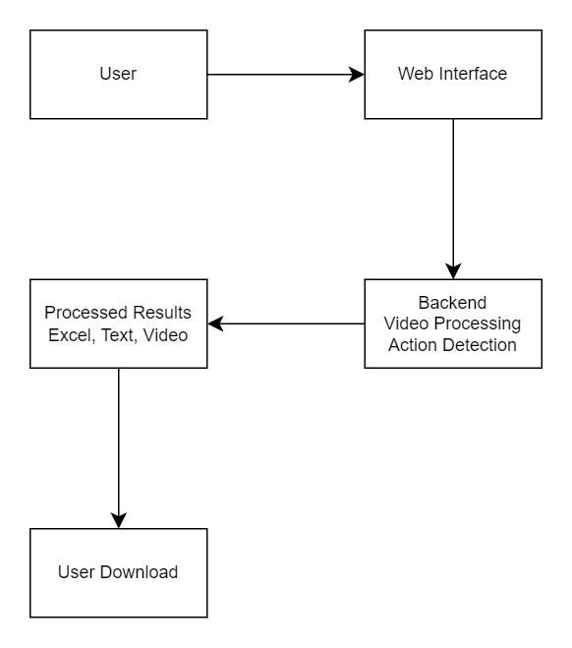
Web Interface Module DFD.

Slide 33
Algorithm of Module 5.
Step 1:Receive the uploaded video file
Step 2:Send The Video to the Backend for processing
Step 3:Receive processed output
Step 4:Display download links for the annotated video and the textual report
Step 5:Display engagement suggestions based on the output data.

Slide 34
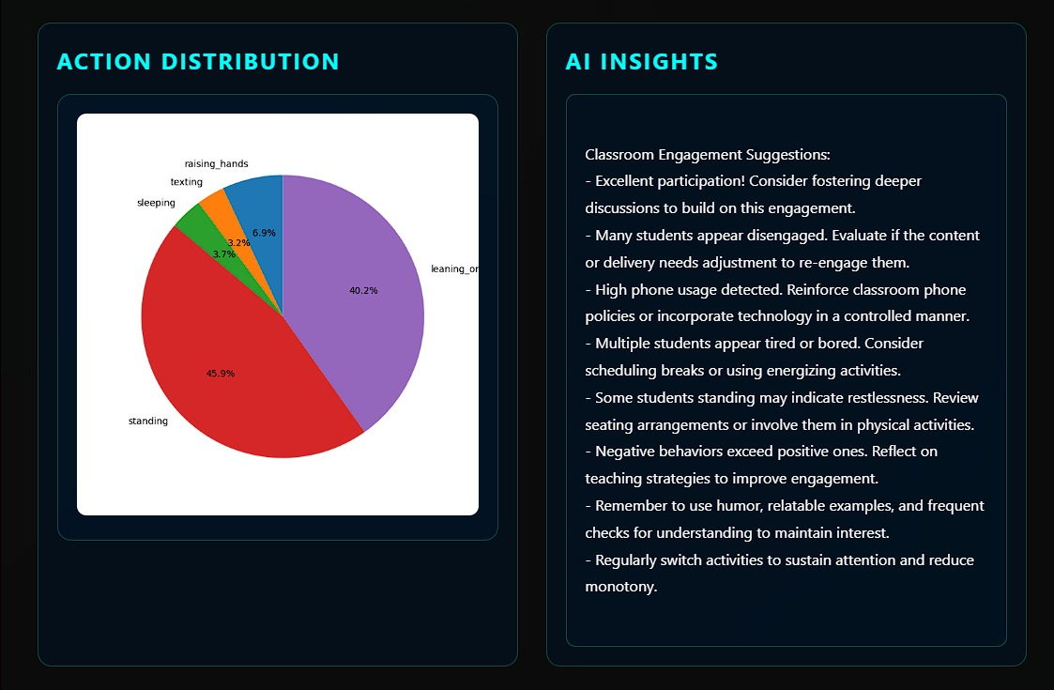
Output of Module 5

Slide 35
Result and Discussion:
Result:
The system successfully processes classroom videos and accurately detects student actions. It generates an annotated video and an Excel report that provides a detailed summary of the detected actions, along with engagement metrics. The system also offers actionable suggestions for teachers based on the detected actions, helping them identify areas where student engagement can be improved.

Slide 36
Result and Discussion:
Discussion:
The results demonstrate the effectiveness of using action recognition models to monitor classroom engagement. The suggestions generated by the system can be a valuable tool for teachers to optimize their teaching strategies. However, the accuracy of the model depends on the quality and diversity of the training data. Expanding the dataset to cover a wider range of classroom behaviors and improving model performance could further enhance the system's reliability in real-world scenarios.

Slide 37
Comparison & Analysis
In comparison to traditional methods of classroom engagement evaluation, such as manual observation or surveys, this automated video-based system provides a more efficient and objective analysis of student behavior. Traditional methods can be time-consuming and subject to bias, whereas the proposed system offers Faster R-CNN Algorithm, unbiased insights based on actual student actions captured on video. The ability to detect specific actions like hand-raising and leaning over the table adds a layer of precision that is often missed in manual observation.

Slide 38
Comparison & Analysis
Analyzing the system's performance, the action detection model demonstrates high accuracy for common gestures, though it may struggle with complex or ambiguous actions depending on lighting and camera angles. Moreover, the system not only provides quantitative results but also gives qualitative suggestions for improving classroom engagement, offering a more comprehensive approach. Future improvements in the action detection model and expanding its application to various classroom settings could further enhance its utility.

Slide 39
Conclusion
These work provides an innovative solution for analyzing classroom engagement by automatically detecting student actions and generating meaningful suggestions for teachers. By leveraging video processing and action recognition models, the system offers a more objective and scalable approach to monitoring student behavior compared to traditional methods. The integration of real-time analysis, actionable feedback, and user-friendly web interface enhances its practicality for classroom environments. While the current model performs well for common gestures, further improvements can be made to refine its accuracy and adaptability. Overall, this system holds great potential in aiding teachers to foster more interactive and engaging learning experiences.

Slide 40
References
Girshick, R. (2015). “Fast R-CNN,” Proceedings of the IEEE International Conference on Computer Vision (ICCV).
Ren, S., He, K., Girshick, R., & Sun, J. (2015). “Faster R-CNN: Towards Real-Time Object Detection with Region Proposal Networks,” Advances in Neural Information Processing Systems (NeurIPS).
LeCun, Y., Bottou, L., Bengio, Y., & Haffner, P. (1998). “Gradient-Based Learning Applied to Document Recognition,” Proceedings of the IEEE, 86(11), 2278-2324.
Karpathy, A., & Fei-Fei, L. (2015). “Deep Visual-Semantic Alignments for Generating Image Descriptions,” IEEE Transactions on Pattern Analysis and Machine Intelligence, 39(4), 664-676.
Nguyen, T. D., & Kiyomoto, S. (2018). “Analyzing Student Behavior in Classrooms Using Convolutional Neural Networks,” Journal of Educational Technology & Society, 21(2), 4-17.
Liu, W., et al. (2016). “SSD: Single Shot MultiBox Detector,” European Conference on Computer Vision (ECCV).
Donahue, J., et al. (2014). “Decaf: A Deep Convolutional Activation Feature for Generic Visual Recognition,” Proceedings of the 31st International Conference on Machine Learning (ICML).

Slide 41
Thank You

